Slide 1
Jimmy’s Personal Effects Bag- How Cotton Has Made a Difference in my Family
By Hannah Burns
For FTT 349W Buffalo State College SUNY Spring 2010

Slide 2
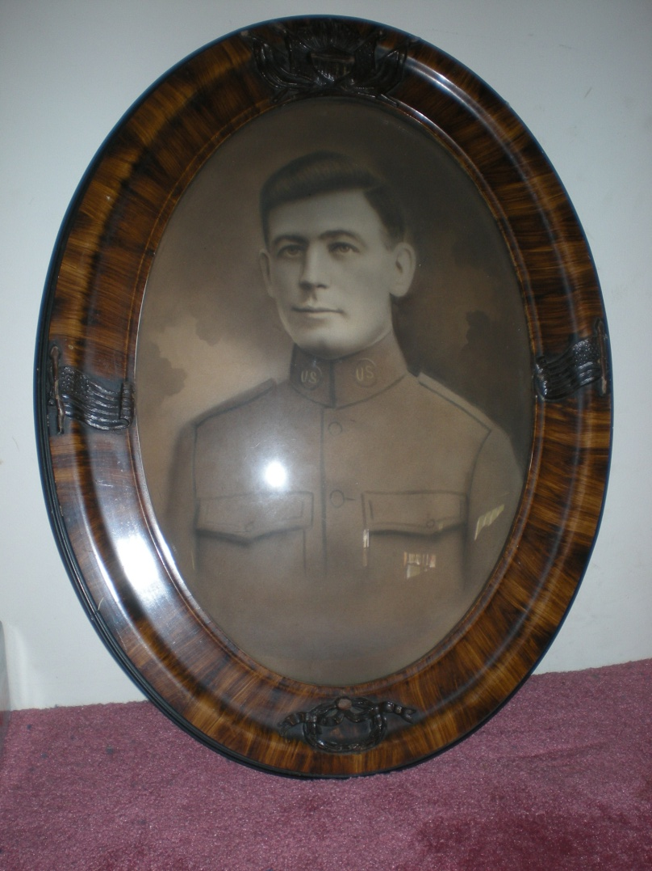
1914 Personal Effects bag
Jimmy Burns
The bag was returned to Jimmy’s family shortly after he died in 1917.
Jimmy was one of 10 kids, him being the eldest, my grandfather Don, being the last.
My father acquired the bag shortly after August of 2007, after my grandfather had passed.
Items most likely lasted so long because the other family members had probably just stuck them in drawer or desk all those past years and forgotten about them
WHO IS JIMMY?
My Great uncle Jimmy Burns, on my dad Mike’s side, who left for the army at 18 years old, in the beginning of World War One.
Unfortunately, Jimmy was killed just 6 days before the war ended in 1917

Slide 3
The bag and its contents
Small bag, presumably made out of cotton
Dirty with rust stains, speckled in fabric discoloration and quite faded.
Soft, and although littered with dirt and rust stains, in good condition and shape.
The bag had thin light blue and grey vertical stripes,
Purpose was to hold soldiers “personal effects”, or treasured items that a solider keeps near to him while he is off at war.
These may have been the only items that separated him personally from every other solider, considering that everything dispensed to soldiers was standard issue.
In this case, his effects were still intact, the bag held a small book of Paris postcards, a sewing kit, identification tag, catholic prayer book, razor and case, and a single stamp

Slide 4
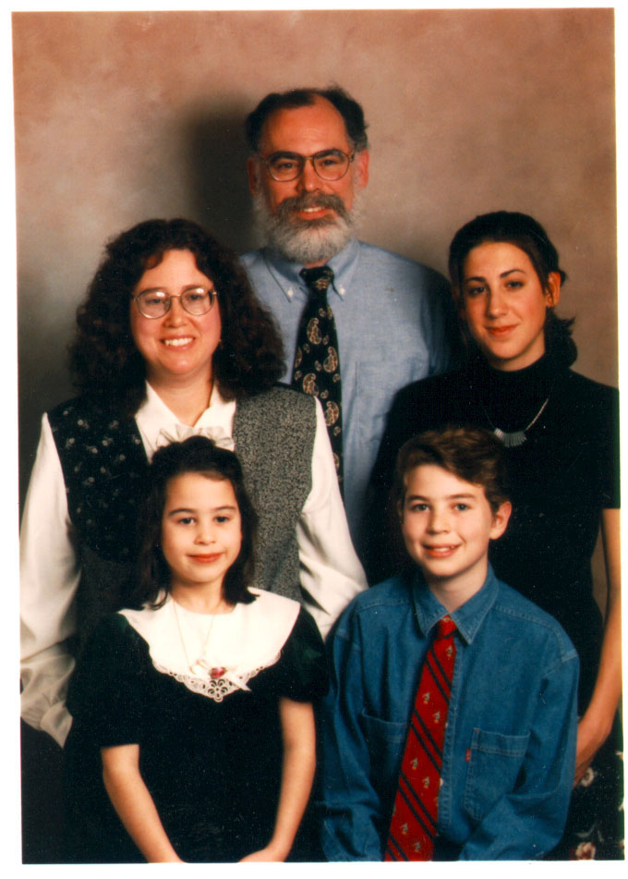
How did it get to my family?
The bag was returned to Jimmy’s family shortly after he died.
Eventually made its way back to Don, who was the youngest of 10 kids.
Mike Burns, (My dad) acquired the box in 2007 after Don passed.
Everything was kept well preserved, and included items such as letters, pictures, photo albums, cards, paper items, and other memorabilia belonging to my family during and after the war

Slide 5
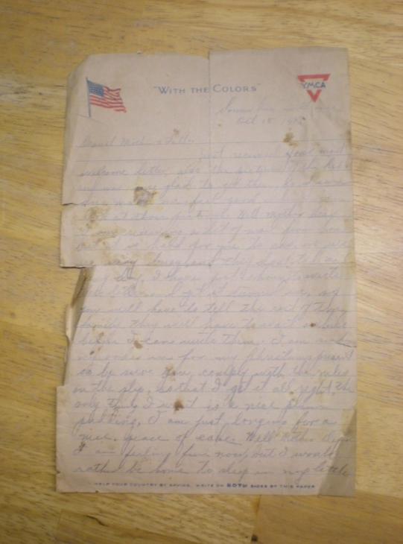
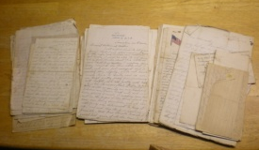
The last letter, 1918
Letters from Jimmy to his family

Slide 6
Timeline
Jimmy- time spent serving the army was limited, gone sometime in February to a training base, trained for about a month or so, then left for battle in England
Killed right before the war ended in November
Jimmy sent home letters when he went in the army, from his time in Fort Dix to up until he was killed in France near the end of the war.
With each letter, my father discovered more and more about Jimmy’s life
Letters were pieces of a historical puzzle about the family

Slide 7
Letters shown a poor light on the state of soldiers in the war.
Jimmy had often begged in his letters for his other brothers to reconsider joining the army because of its extremely rough conditions. Jimmy insisted for them to find jobs in Buffalo.
Jimmy longed for home with each letter.
Letters revealed that before Jimmy went in the army, his other brother Leo, who was in the insurance business, sold him a policy before he left for war.
Surprising to my father because he had actually known Leo, (his uncle), but had no knowledge of this transaction
After only five or six months in the army, Jimmy got the insurance policy letters.
Jimmy wrote home asking if the policy would still pay off if he didn’t survive the war.

Slide 8
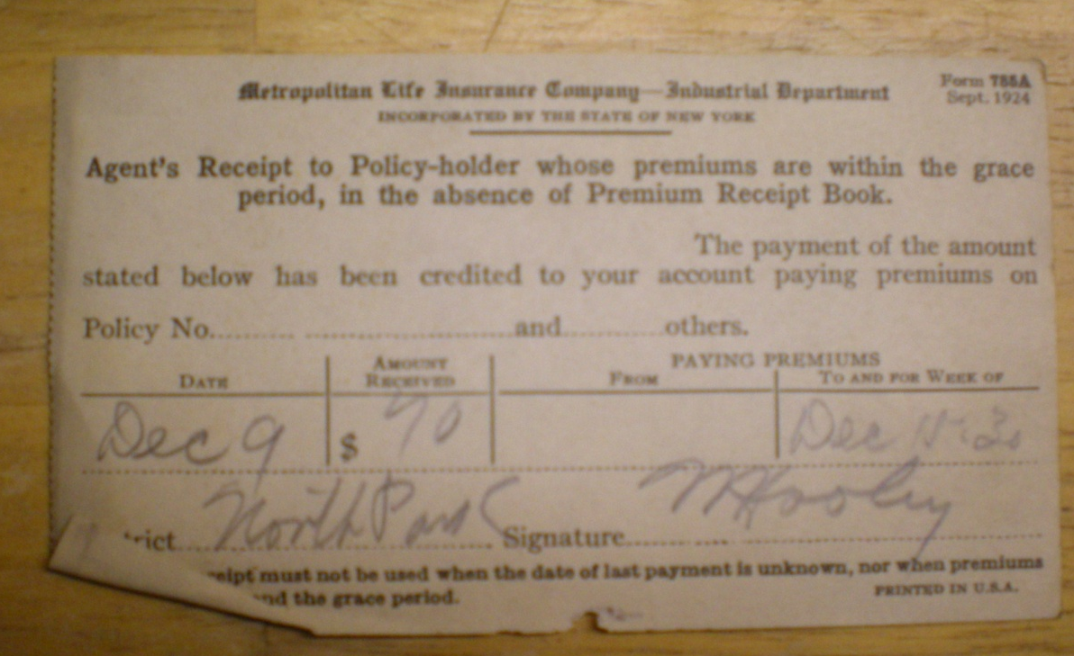
Jimmy died in battle close to the end of the war, which allowed for the policy to pay off to Jimmy’s father.
The checks paid about 57$ dollars a month, allowing for a total of about $10,000 over the course of twenty years.
Sufficient amount of extra income for the time period.
The checks began to be delivered in about 1920’s, up through the Great Depression and lasted until about 1940, spanning over several generations of kin

Slide 9
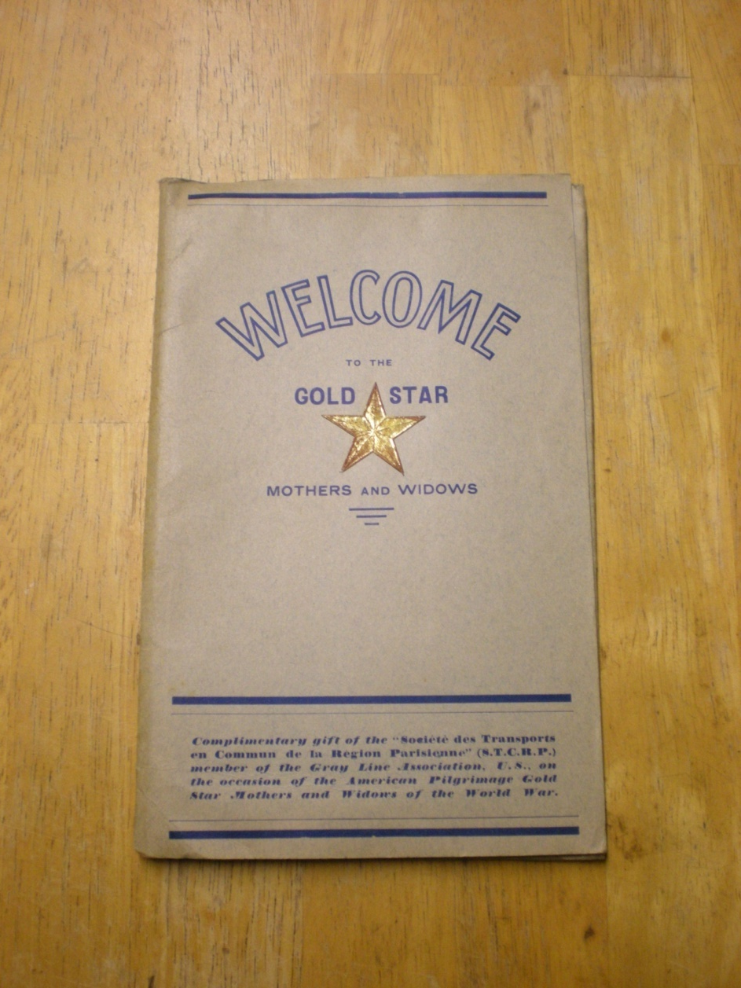
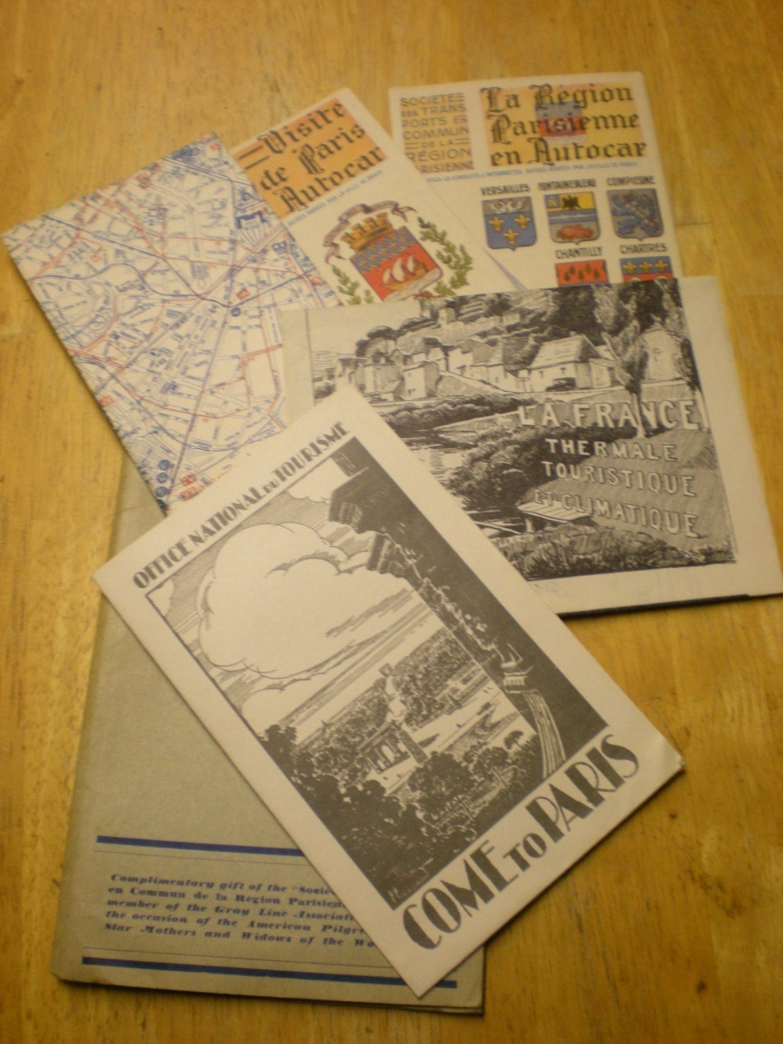
“Gold Star Club” for widows and mothers
The president invited my Great Grandmother to Paris to visit Jimmy’s grave

Slide 10
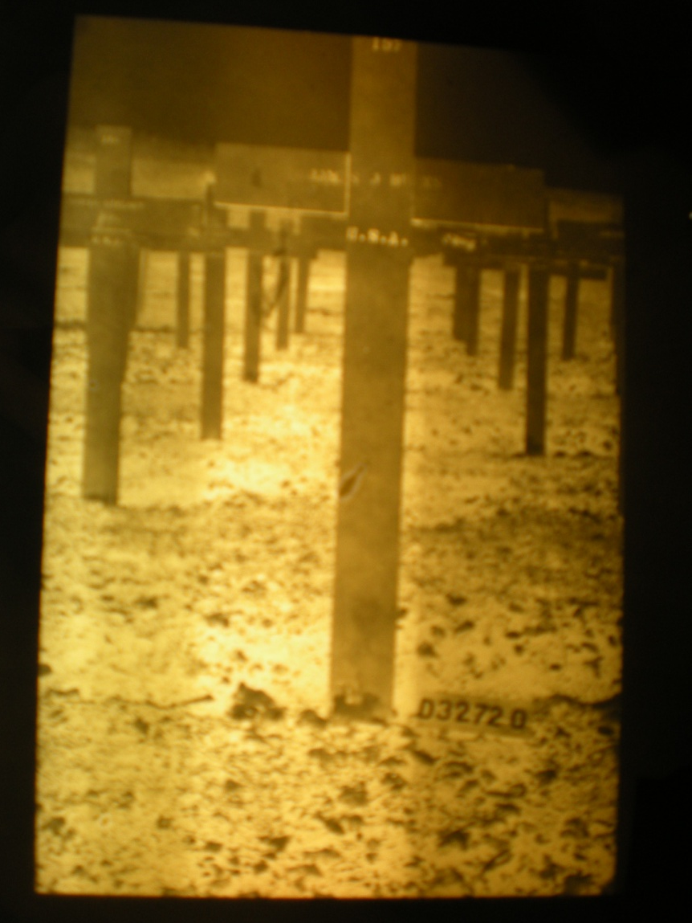
Jimmy’s Grave in Paris

Slide 11
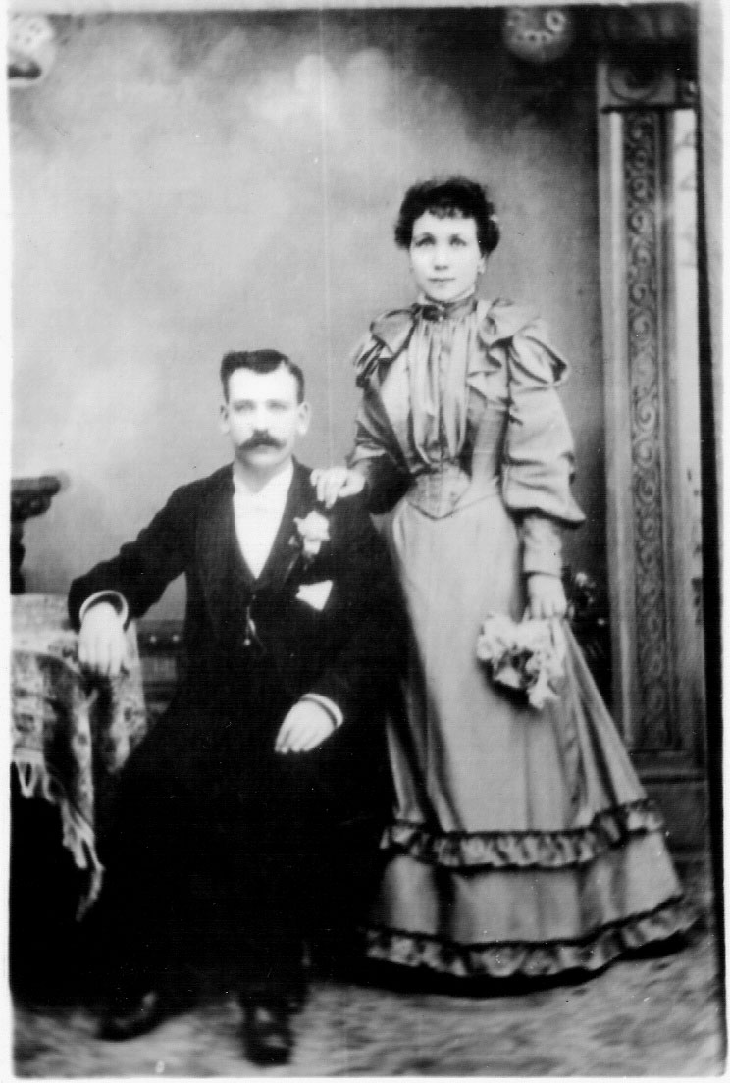
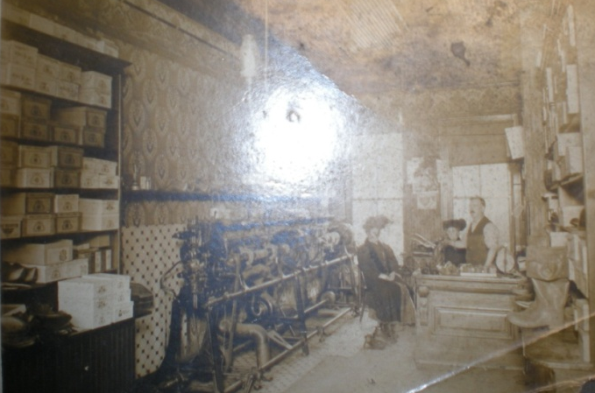
Impact on the burn’s family
Jimmy’s father- shoemaker, lived on the poorer side of Buffalo. Ran a small shop on Niagara Street that made specialized shoes, for people with bad feet.
This was a man who was supporting a wife, and during his lifetime had 10 kids.
The money the family received from Jimmy’s policy changed everything. It allowed the family to live more than comfortably through the Great Depression, and overall it completely changed the
family’s lifestyle.

Slide 12

Impact on the Burns Family
With the extra income, Jimmy’s three brothers; Bob, Tom and Don (Mike’s father and my grandfather) were able to go to not only high school, but private high school at Canisius College in Buffalo
Attending the high school provided great opportunities for the family, and Bob eventually went into priesthood, later teaching at the school

Slide 13
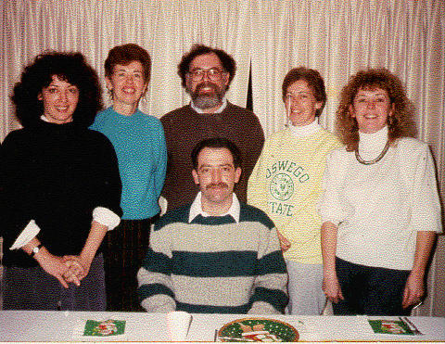
Impact on the Burns family
Went from struggling with finances to support his large family, to living comfortably during the depression, a time when even the upper class was struggling financially.
The extra weekly income truly made a difference; The connections made at Canisuis gave the boys a chance to better their educations and expand opportunities
After Don finished high school at Caniusis, he decided to continue his education by attending Caniusis College.
Graduated in 1937
His college degree allowed him to get well paying job as a purchasing agent, a white collar job compared to factory jobs.
His income allowed
him to move his family from the crowded city to the suburbs, giving his children more opportunities and better education options.

Slide 14
“ironic and bittersweet”
A situation of tragedy- the misfortune of losing your oldest son to war- was able to help a family escape the lower class and be able to pay for education for the siblings.
Jimmy’s loss enabled his family to survive and better themselves during a time of great economic turmoil

Slide 15
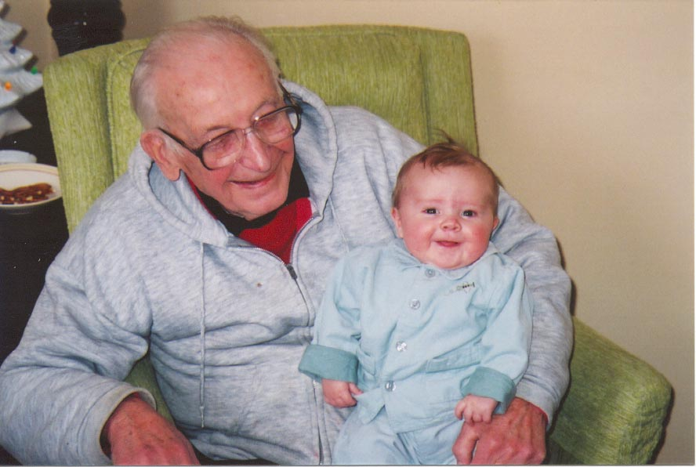

Don’s Pride
Don had never talked about the box of items to my father, although he did mention Jimmy several times to my father’s family. Growing up, my father remembers Don treating him as part of the family, although he never knew him. Don had a tremendous respect for him, which may be in part why my father didn’t find out about the insurance policy until after Don died.
It is obvious that the whole Burn’s family held high respect for Jimmy, as seeing his items were never thrown out or hastily taken care of, but instead passed down to the next generation

Slide 16
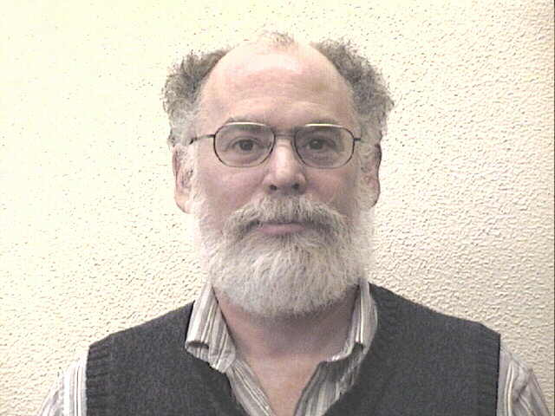
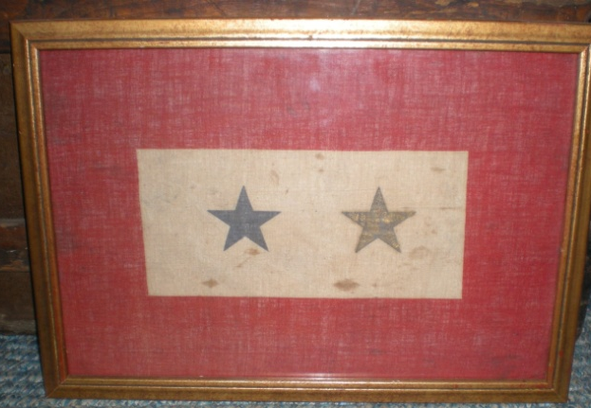
Mike’s pride
Mike spent a large amount of time on going through each one the items and trying to learn about their significance to World War one and relevance to our family.
Read each one of Jimmy’s letters from start to finish.
Not easy, considering the letters easily exceed over 50, and contained uncommon slang and phrases from the time period.
Some were stained with dirt and deteriorating, all in cursive
His final hopes for the items were to keep
Them as well preserved so that he can
pass it on to his kids and his grandchildren
Today, my father hangs a portrait of
Jimmy in a cabin we have in my parents
backyard, along with a framed picture
featuring two foil stars that was given to
Jimmy’s mother after he died.
The rest Jimmy’s letters and war memorabilia
are safe in my parent’s basement which is kept
cool and dry,
imperative to
their
preservation.

Slide 17
My Feelings
Completely changed since I first learned about the assignment.
First-not pleased to learn it was some small piece of boring cotton
As I interviewed my dad, I was fascinated to learn the story behind it and its impact on our family.
It is nice to think that by that time the items will be incredibly old, and I can share the knowledge I learned about the items from the dad with my own children.
It is truly incredible to see how a little cotton plant can become a textile that tells such an elaborate and impacting story. Over time, this little cotton bag has meant so much to many people, both alive and passed. It has affected many different lives in so many ways, and will continue to effect lives as its story is passed on for generations to come.

